Slide 1
Genome assembly and annotation Day 1: UNIX and CSC
MMB-114 Exploratory microbial research - lab course 2019
Igor Pessi
Department of Microbiology – UH
igor.pessi@helsinki.fi

Slide 2
Aims for this part of MMB-114
Day 1: Basics of UNIX and working with the command line
Day 2: Handling of Illumina data
Day 3: Genome assembly
Day 4: Check-up and report
Day 5: Genome annotation
Day 6: Metabolic pathway analysis
Get reads
Sequence quality trimming
Genome assembly
Genome annotation
Metabolic pathways

Slide 3
What’s the deal with genomics?

Slide 4
The evolution of sequencing
Features
Read size
Read depth (output)
Error rates
Price
http://dx.doi.org/10.6084/m9.figshare.100940

Slide 5
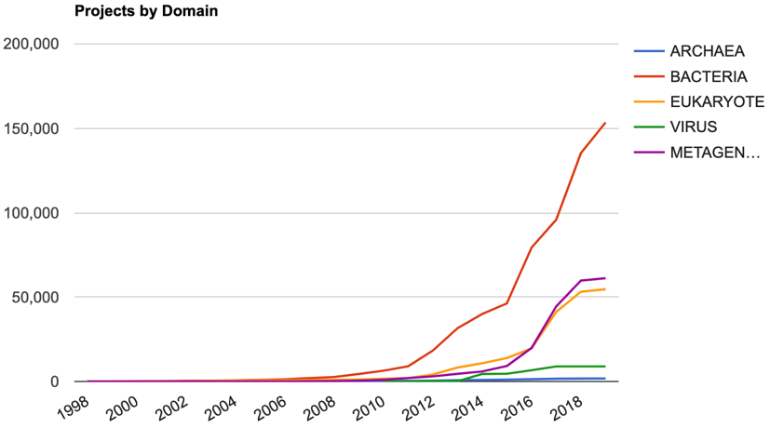
Genomes OnLine (GOLD) database
Type strains
Bacteria: 15,557
Archaea: 558
From 1 genome/year in the late 90’s… …to 7 genomes/day in 2018
https://gold.jgi.doe.gov

Slide 6
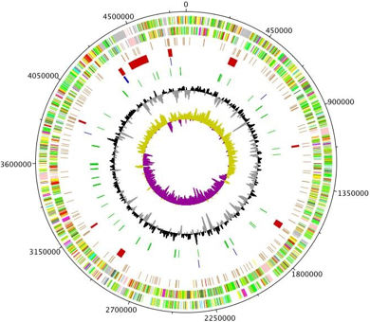
Genomics can be used in
Physiology
Evolution
Pathogenesis
Novel industrial processes
Novel diagnostic/epidemiologic tests

Slide 7
Ammonia-oxidizing (nitrifying) archaea
Nitrifiers = obtain energy from the oxidation of ammonia
Initially thought thought to be performed mainly by bacteria
Nitrosomonas, Nitrosospira, Nitrobacter
Recent ’omics studies have revealed the importance of ammonia-oxidizing archaea
Thaumarachaeota
Novel gene inventory
Higher substrate affinity
Different pathways

Slide 8
Genome evolution
Mutations
Synonymous and non-synonymous
Small insertions and deletions
Can change the function of a gene
Gene recombination, deletion, duplication
Rearrange genes, can change expression
Increase in gene copy numbers
Deletion of genes
Horizontal gene transfer
Acquiring material from non-parental organism
Antibiotic and xenobiotic resistance, toxin production

Slide 9
The (new) microbial tree of life
Isolation of most microorganisms from the environment is not trivial
Recent metagenomic assessments suggest the existence of up to 1 trillion microbial species in our planet
But < 10,000 bacterial species have been described so far
Groups without cultured representatives
Hug et al. 2016
Nature Microbiology
doi:10.1038/nmicrobiol.2016.48

Slide 10
Whole genome sequencing in diagnostics and epidemiology
Pathogen identification and outbreak monitoring
Several phenotypic and molecular methods are currently used
Fail to distinguish closely related strains or detect virulence/resistance features
WGS soon will become the standard test in diagnostics and epidemiology
Increased speed and accuracy
Reduced cost and difficulty
Trial phase of implementation in many countries
European E. coli O104:H4 outbreak in 2011
Shiga toxin-producing E.coli
3,950 cases reported
WGS with Ion torrent, 454 pyrosequencing and PacBio
Included strains that could be distinguished by just 1 SNP
Origin could be identified (fennel sprout seed)

Slide 11
Our Lactobacillus strain
What was done by you in the lab?
Isolation/purification of the microorganism
DNA extraction
Important points?
Purity, integrity, contamination DNA
What was done in the sequencing facility?
Quality control (size, amount)
Library preparation with the Nextera kit
Sequencing with Illumina MiSeq

Slide 12
Illumina library preparation and sequencing
Illumina MiSeq and HiSeq
Good compromise between size, amount and error rate of reads
The longer the reads the better, but current long-read technologies produce too many errors
Let’s watch a video together and then we will discuss some features in more detail:
https://www.youtube.com/watch?v=fCd6B5HRaZ8

Slide 13
Library preparation: Nextera tagmentation
Size selection
Correct amount of input DNA to avoid under- and overtagmentation
Adapter ligation
Flow cell adapters
Sequencing primers
Sequencing indexes
Optional indexes for multiplexing
Biases in the first bases have been observed

Slide 14
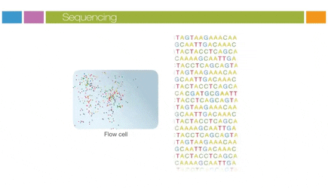
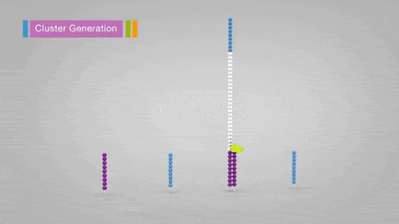
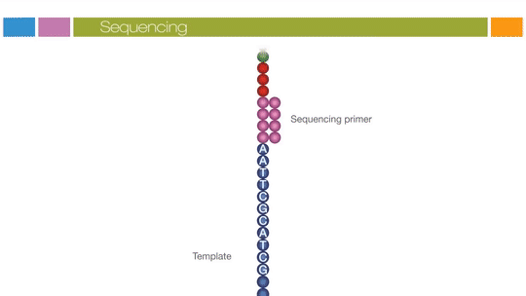
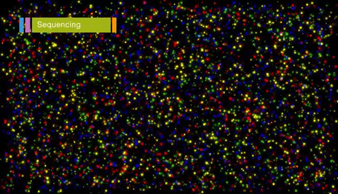
Sequencing

Slide 15
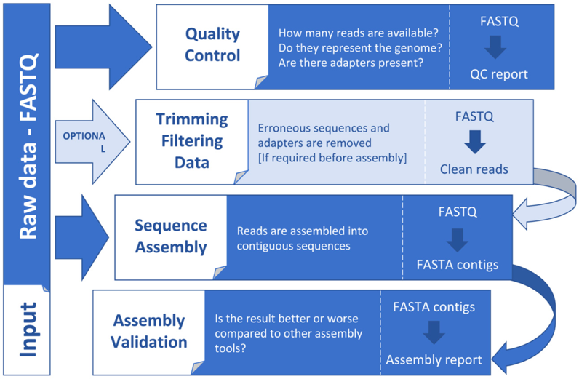
What now?
Dominguez Del Angel et al. 2018
F1000Reseach
doi: 10.12688/f1000research.13598.1

Slide 16

Bioinformatics
Interdisciplinary field that develops and applies computational methods to analyse biological data such as DNA and protein sequences
Biology meets information science
A rapidly-evolving field
Software development
Amount and type of data generated

Slide 17
UNIX
A family of computer operating systems (OSs)
Linux, MacOS, Solaris, OpenBSD
Key characteristics:
Multitasking
Multiple software processes can run at the same time
Multiuser
Several users can use the same computer at the same time
Multiprocessing
Capable of supporting and utilizing more than one computer processor
Portable
Can be used in various hardware architectures

Slide 18
History of UNIX
https://commons.wikimedia.org/wiki/File:Unix_history-simple.svg

Slide 19
Linux
A UNIX-based OS
Leading OS on servers, supercomputers
Free and open source
You can modify the source code to build your own distribution
Or you can use mainstream distributions such as Ubuntu and CentOS
More specific distributions are available (e.g. Bio-Linux)

Slide 20
The UNIX philosophy
“The idea that the power of a system comes more from the relationships among programs than from the programs themselves”
Use of plain text for storing data
Use of a hierarchical filesystem
Use of a large number of simple programs performing a limited, well-defined function
Use of a command-line interpreter (“shell”) to combine these programs to perform complex tasks

Slide 21
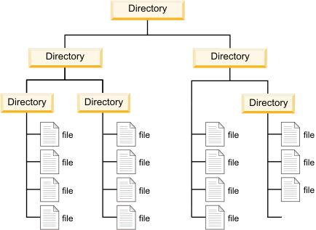
The UNIX hierarchical filesystem

Slide 22
The UNIX hierarchical filesystem
https://www.linux.com/sites/lcom/files/styles/rendered_file/public/standard-unix-filesystem-hierarchy.png?itok=CVqmyk6P

Slide 23
The UNIX hierarchical filesystem
/
bin
usr
home
bin
lib
Documents
Downloads
Pictures
Videos
Research
Teaching
MMB-114
/home/Documents/Teaching/MMB-114

Slide 24
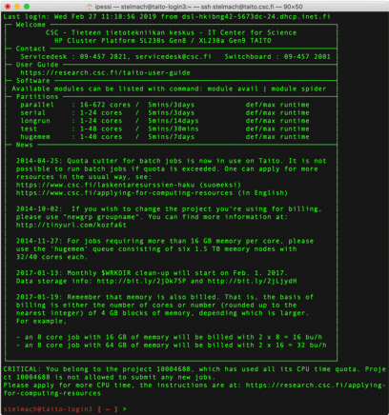
The UNIX shell
Command-line interpreter
Interprets sequences of text
Entered by a user
From a file
From a data stream
Primary interface before graphical user interfaces (GUIs) appeared
Still widely used today
Efficient
Lower memory footprint
Advanced scripting

Slide 25
The UNIX shell on Windows 10
https://www.howtogeek.com/249966/how-to-install-and-use-the-linux-bash-shell-on-windows-10

Slide 26
Some basic UNIX commands
pwd: print working directory (“where am I?”)
ls: list (“show folder contents”)
mkdir: make directory (a.k.a. folder)
cd: change directory (“go to folder”)
cp: copy
mv: move
rm: remove

Slide 27
Some additional notes
Case-sensitive
photo.jpg ≠ PHOTO.jpg
Does not like spaces and special characters in file/folder names
genome report.txt ❌
genome_report.txt ✅
väitöskirja.txt ❌
vaitoskirja.txt ✅
Space after each “word” in the command
Commands have to be typed in a single line, one at a time
After each command, hit “Enter” to execute it
Lines starting with “#” are comments
A few tricks:
Tabulator
History

Slide 28
How to learn UNIX?
By using it!
Trial and error
Don’t copy and paste it, type it
Ask the internet, e.g.:
http://stackoverflow.com/
http://stackexchange.com/
http://askubuntu.com/
Google!
Online courses/tutorials, e.g.:
http://codecademy.com
Cheat sheets, e.g.:
http://mally.stanford.edu/~sr/ computing/basic-unix.html
Manual (“man”) pages
man splain

Slide 29
CSC - IT CENTER FOR SCIENCE
Working with ‘omics data is computing-intensive
Use of high-performance computers (HPC)
a.k.a. supercomputers
Sisu
Taito

Slide 30
Folder structure in Taito
/
HOME folder:
- Initialization scripts, source codes, small files
- Not for running programs or research data
- Small (50 Gb)
- Backed up routinely
- Access:
cd
cd ~
cd $HOME
WORK folder:
- Temporary storage of datasets that are actively used
- Large (5 Tb)
- Not backed up!
- Access:
cd $WRKDIR
homeappl
wrk
home
youruser
youruser
https://research.csc.fi/taito-user-guide

Slide 31
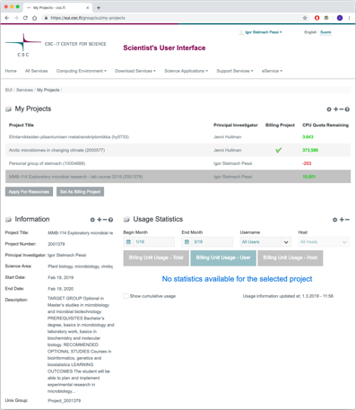
Before we start, change the billing project in CSC
Login to https://sui.csc.fi/
Go to eService / My Projects
Select “MMB-114 [..]”
Click “Set as Billing Project”
Click “Yes” to confirm

Slide 32
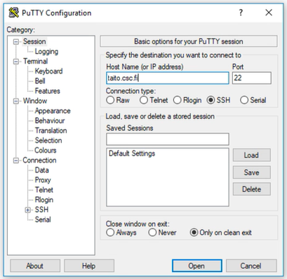
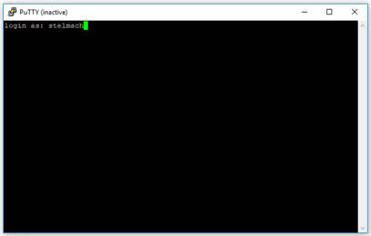
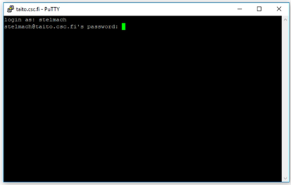
Connecting to Taito: Windows users
Launch PuTTY
In “Host Name (or IP address)”, type taito.csc.fi and click “Open”
In the following dialogue window, choose “Yes”
Type your CSC username and hit “Enter”
Type your password and hit “Enter”
To logout just type exit and hit “Enter”

Slide 33
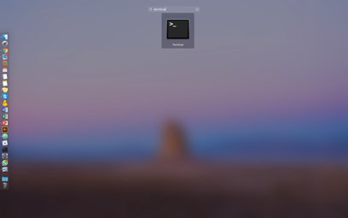
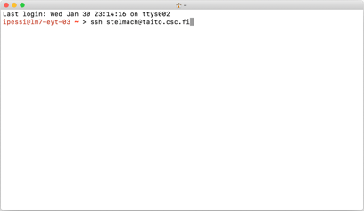
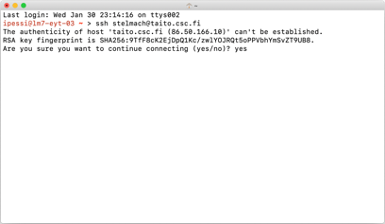
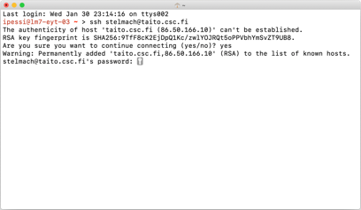
Connecting to Taito: MacOS users
Launch Terminal
e.g. open the Launchpad and type terminal
Type ssh user@taito.csc.fi and hit “Enter”
Change “user” for your own CSC username
In the following dialogue, type yes and hit “Enter”
Type your password and hit “Enter”
To logout first type exit, hit “Enter”, and close the Terminal window

Slide 34
Time to familiarize yourself with UNIX
https://github.com/igorspp/MMB-114
(Day 1: UNIX and CSC)

